Slide 1
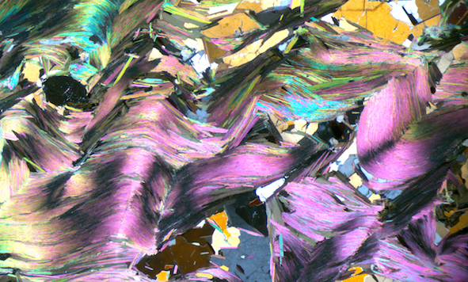

⁴⁰Ar/³⁹Ar Thermochronology: Diffusion and Dodson
Clare Warren
Helsinki,
24 October 2017

Slide 2
Learning Outcomes
You will gain an understanding of:
Diffusion in minerals and rocks
Closure temperature
The assumptions behind the Dodson T_{C} formulation
You will be able to:
Calculate closure temperatures

Slide 3
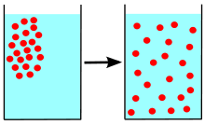
Diffusion
Image: Wikipedia

Slide 4
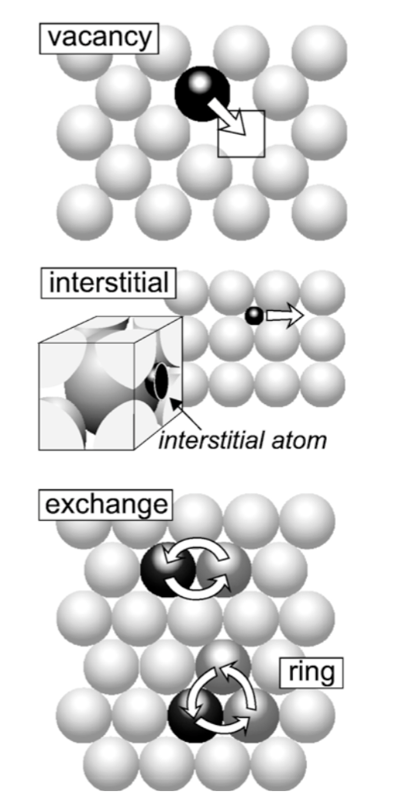
Diffusion in Minerals
Image: Watson + Baxter 2010

Slide 5
Low concentrations: random walk
High concentrations: smooth and deterministic
By Sbyrnes321:, https://commons.wikimedia.org/w/index.php?curid=8995324

Slide 6
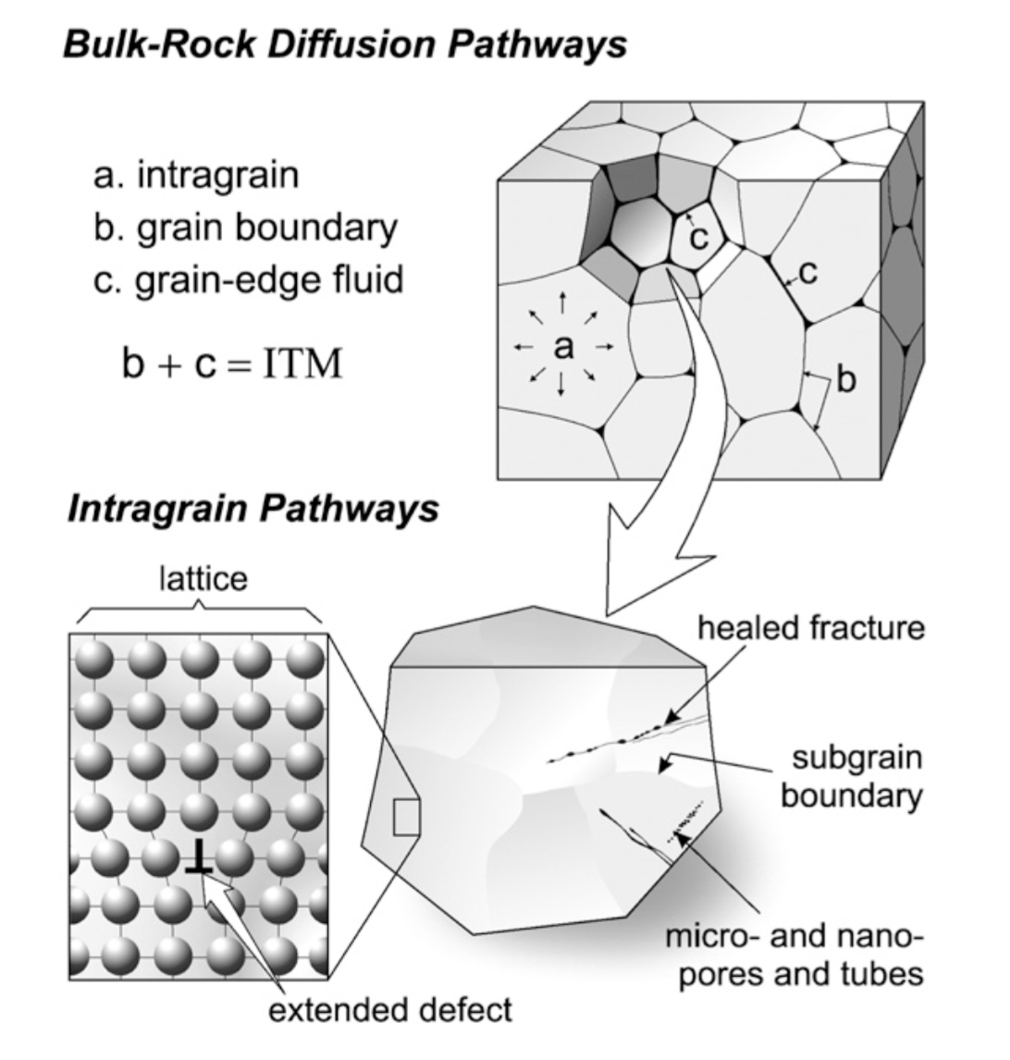
Diffusion in Rocks
Not volume diffusion
Could be barriers or pathways
Image: Watson + Baxter 2010

Slide 7
Closure Temperature
⁴⁰Ar
⁴⁰Ar
Daughter product escapes
High
⁴⁰Ar
⁴⁰Ar
Temperature
Closure region
Daughter product is retained
Low
⁴⁰Ar
⁴⁰Ar
⁴⁰Ar

Slide 8
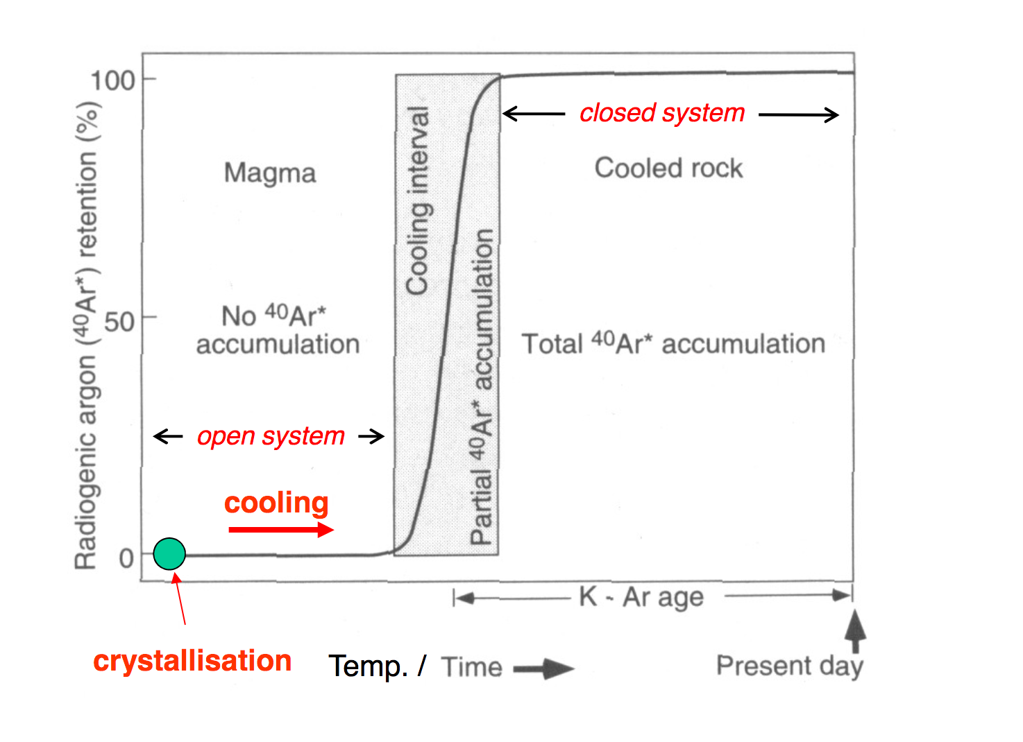
Image: http://studylib.net/doc/18050406/ar-ar-geo--thermochronology

Slide 9
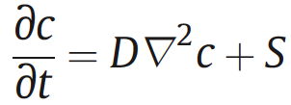
Fick’s 2nd law of diffusion
This equation describes the concentration (of argon) in 3 dimensions as a function of space and time
C= concentration
D = diffusion coefficient
∇² = (x,y,z directions)
S = source term (Ar is being created over time)

Slide 10
Linking age to T: Dodson T_{c}
T_{c}=R / [E_{a} ln(AτD₀ /a²)]
τ = -RT²/(E dT/dt)
R = gas constact
E_{a}= activation energy
A = shape factor (line, plane, sphere)
τ= time constant with which D diminishes with T
D₀ = diffusion coefficient
a = diffusion radius
Dodson, CMP, 1973

Slide 11
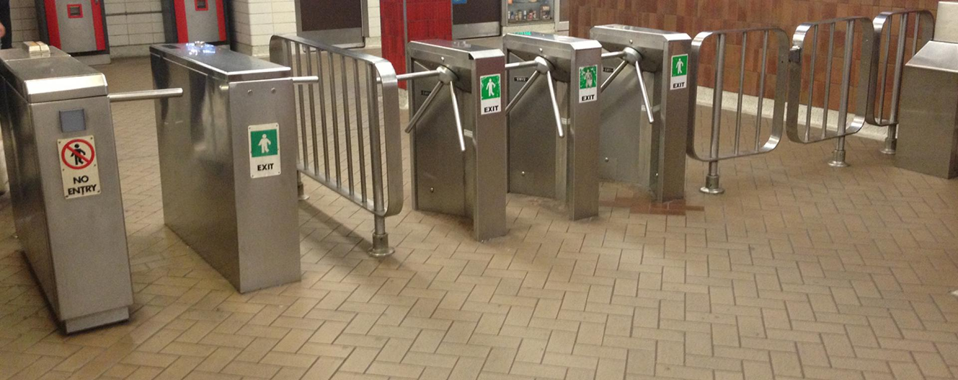
10
X

Slide 12
10
10+10
-3
X

Slide 13
10
10+10
-3
10+10+10
-3-3
X

Slide 14
10+10
-3
10+10+10
-3-3
10+10+10+10
-3-3-3
10
X

Slide 15
10+10
-3
10+10+10
-3-3
10+10+10+10
-3-3-3
10+10+10+10+10
-3-3-3-3
10
X

Slide 16
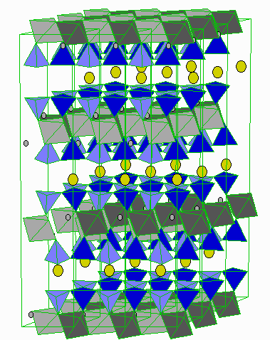
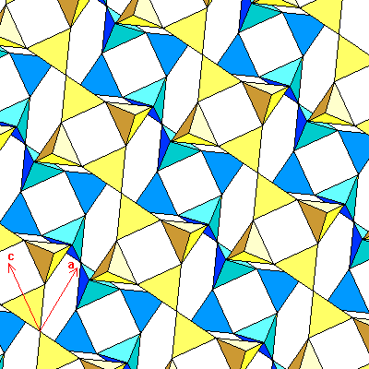
Remember minerals have different lattice properties
Mica: cylinder (2D)
Feldspar: sphere (3D)
Images: ruby.colorado.edu and uwgb.edu

Slide 17

Create a T_{c} Spreadsheet for muscovite
Constants:
R = 1.986 x 10⁻³ kcal/K/mol
D₀= 2.3 cm² s⁻¹ (Harrison et al., 2009)
E_{A}= 63 kcal mol⁻¹
A = 27 for cylinder
Let’s use a grain radius of 0.05 cm
And a cooling rate of 10 K Ma⁻¹ (convert to K s⁻¹)
What is T_{C}?
Hint: you will need to iterate. Choose a starting temperature to calculate τ, then iterate from that value
T_{c}=R / [E_{a} ln(AτD₀ /a²)]
τ = -RT²/(E dT/dt)

Slide 18
Now calculate and plot a graph of:
Closure T for muscovite for cooling rates from 0.01 to 100 K Ma⁻¹
For grain radii of 0.001 to 1 cm

Slide 19
Well done!
You can use this spreadsheet to calculate Tc of:
Ar in other minerals
He in other minerals
Pb in other minerals….
Basically diffusion of any radiogenically-produced element in any mineral.

Slide 20
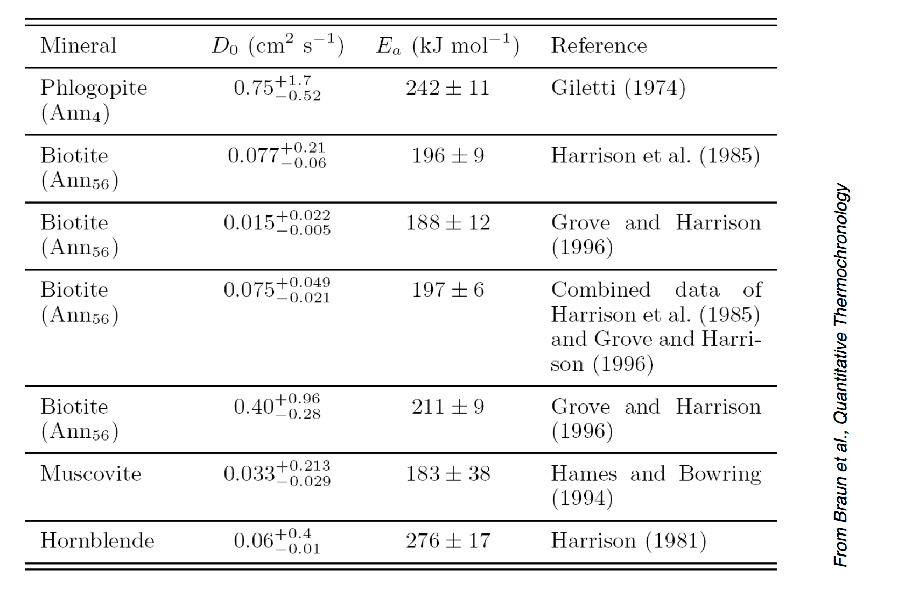
*
Now been updated by Harrison et al., 2009

Slide 21
What approximations are involved in using T_{C} to link age to temperature?

Slide 22
Linking ⁴⁰Ar/³⁹Ar ages to temperature: assumptions
K K K K K K K K K K K K K K K
K K K K K K K K K K K K K K K
K K K K K K K K K K K K K K K
K K K K K K K K K K K K K K K
K K K K K K K K K K K K K K K
No initial Ar in grain

Slide 23

Linking ⁴⁰Ar/³⁹Ar ages to temperature: assumptions
K K K K K K K K K K K K K K K
K K K K K K K K K K K K K K K
K K K K K K K K K K K K K K K
K K K K K K K K K K K K K K K
K K K K K K K K K K K K K K K
No initial Ar in grain
Thermally-activated volume diffusion

Slide 24
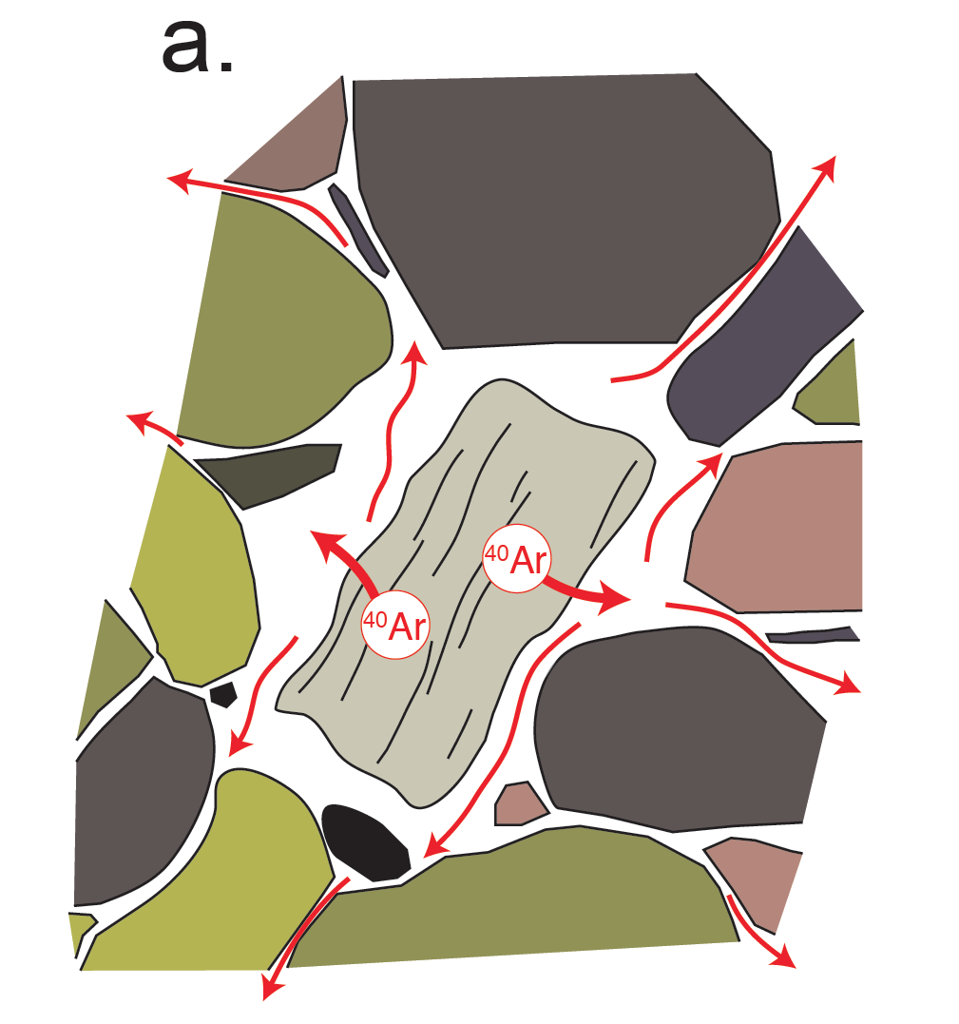
Linking ⁴⁰Ar/³⁹Ar ages to temperature: assumptions
K K K K K K K K K K K K K K K
K K K K K K K K K K K K K K K
K K K K K K K K K K K K K K K
K K K K K K K K K K K K K K K
K K K K K K K K K K K K K K K
No initial Ar in grain
Thermally-activated volume diffusion
Infinite grain boundary reservoir (open system)
A. Smye

Slide 25
Linking ⁴⁰Ar/³⁹Ar ages to temperature: assumptions
K K K K K K K K K K K K K K K
K K K K K K K K K K K K K K K
K K K K K K K K K K K K K K K
K K K K K K K K K K K K K K K
K K K K K K K K K K K K K K K
No initial Ar in grain
Thermally-activated volume diffusion
Infinite grain boundary reservoir (open system)
T_{crystallisation} >> T_{closure}
A. Smye

Slide 26
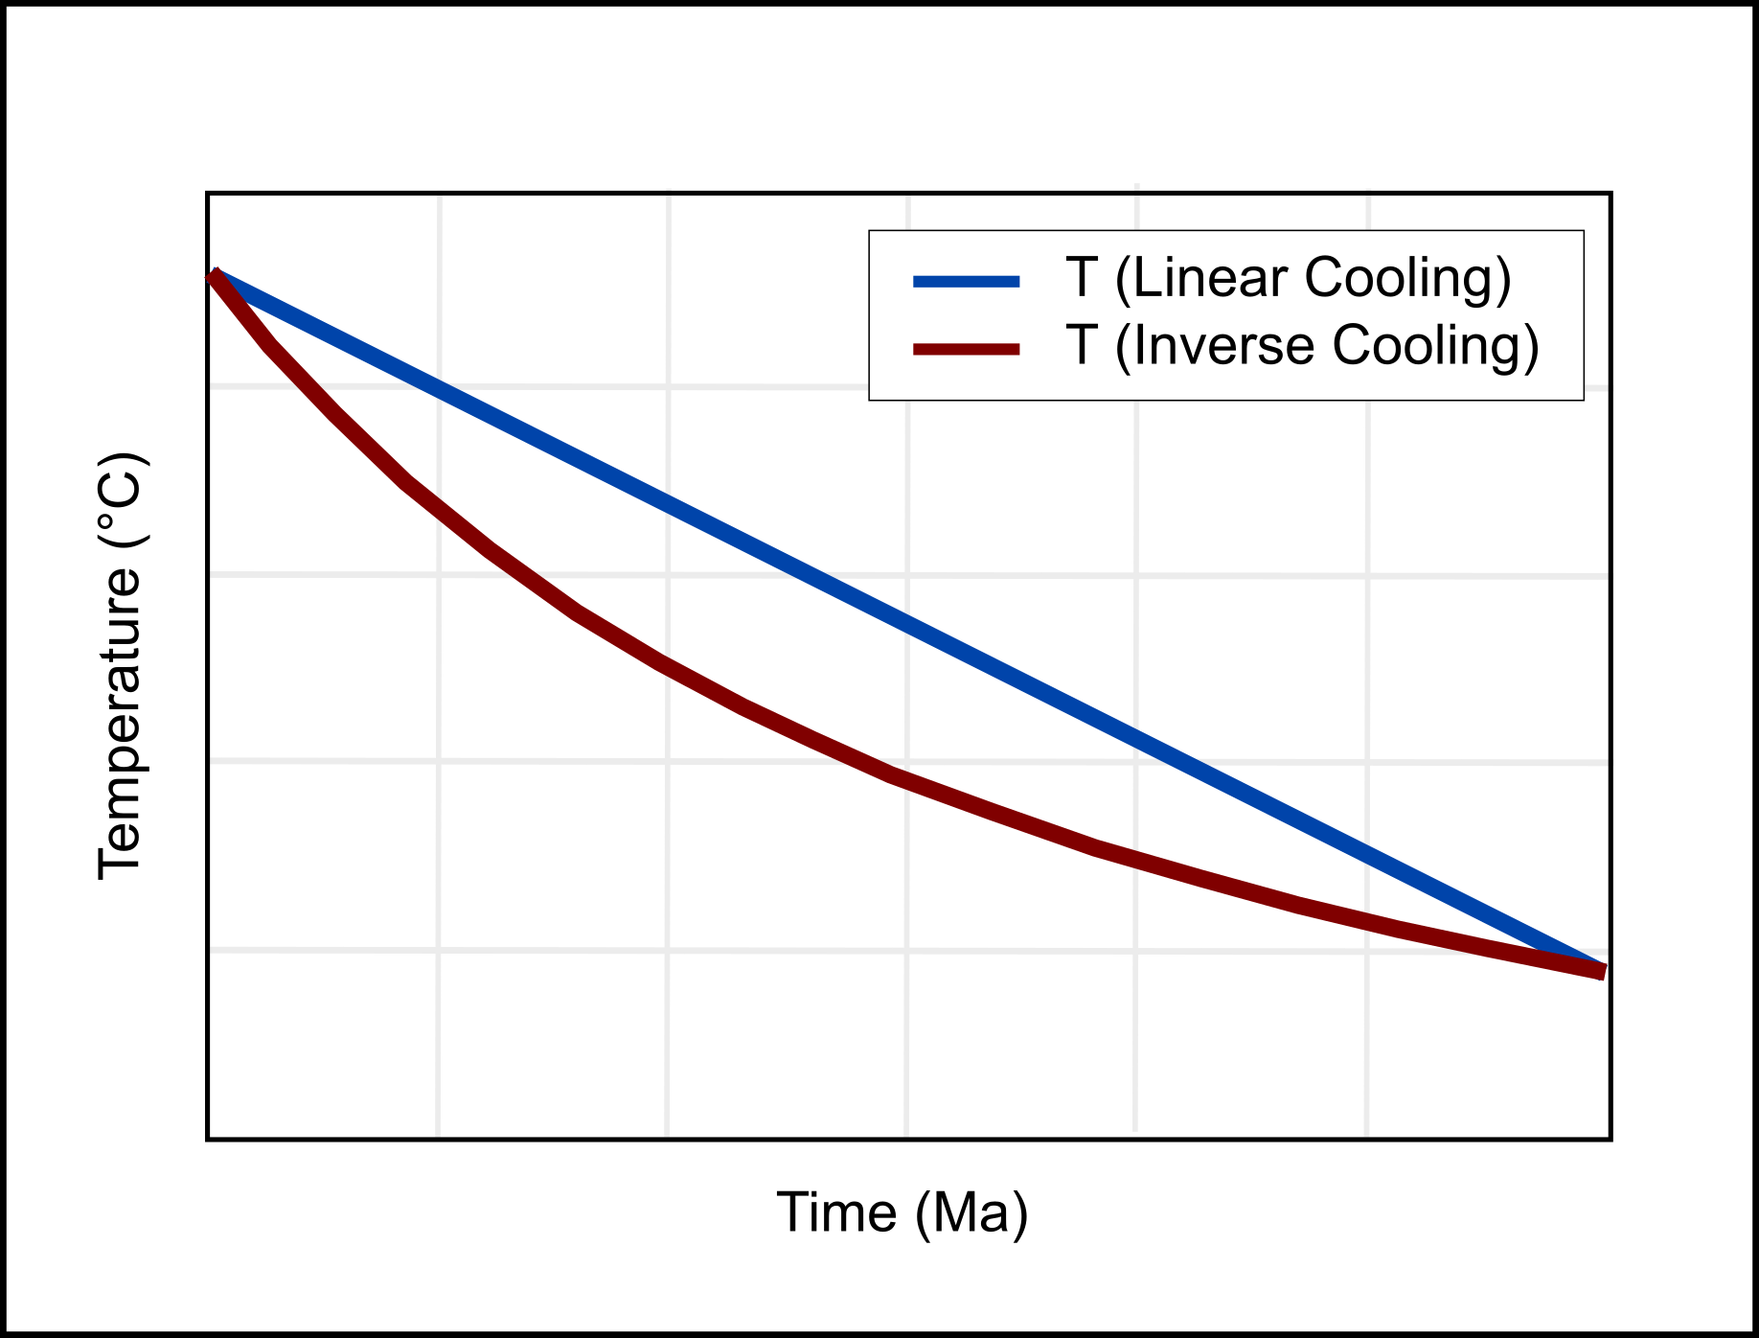
Dodson: Specific 1/T cooling path
Our normal assumption
The Dodson solution requirement

Slide 27
Conditions for the Dodson solution
Initially, concentration = 0
Where does the time dependence sit?

Slide 28
Conditions for the Dodson solution
Initially, concentration = 0
Where does the time dependence sit?
In S (source term)
In D = D₀ exp(-E_{a} / RT) (temperature linked to time)
Analytical solution possible if E_{a}/RT is linear with time
i.e a 1/time temperature dependence (messy!)

Slide 29
Linking ⁴⁰Ar/³⁹Ar ages to temperature: assumptions
K K K K K K K K K K K K K K K
K K K K K K K K K K K K K K K
K K K K K K K K K K K K K K K
K K K K K K K K K K K K K K K
K K K K K K K K K K K K K K K
No initial Ar in grain
Thermally-activated volume diffusion
Infinite grain boundary reservoir (open system)
T_{crystallisation} >> T_{closure}
Shouldn’t use Dodson’s formulation
unless these assumptions are satisfied
How can we tell? That’s up next…
A. Smye

Slide 30
Learning Outcomes
You will gain an understanding of:
Diffusion in minerals and rocks
Closure temperature
The assumptions behind the Dodson T_{C} formulation
You will be able to:
Calculate closure temperatures

